Slide 1
POLYTENE CHROMOSOME
Study Material for
B.Sc. Part II
Botany Hons.
Paper IV
Dr. Pushpanjali Khare
Sr. Asstt. Professor &
Head, Deptt. of Botany
MMC (PU)
Patna

Slide 2
POLYTENE CHROMOSOMES
Polytene Chromosomes are one of the Giant Chromosomes
These are also known as Salivary Gland Chromosomes as they are found in salivary glands of Dipterans (Fruit fly) larvae
Exceptional feature: Polytene chromosomes are visible during interphase
Polytene chromosomes were first of all observed by Balbiani (1881) in the salivary glands of the non biting midge (lake fly) chironomous
Polytene chromosomes have been reported in immature seed tissues (P. vulgaris, P. coccineus) by Nagl in1981 and in anther tapetum of Vigna unguiculata (Guerra and Carvalheira, 1994)
In Polytene chromosomes there are several Bands and Interbands representing the heterochromatin and euchromatin regions
Bands are regions of high DNA concentration whereas Interbands are regions of low DNA concentration
Painter (1933)and Bridges (1936) studied about the close relationships between Band and genes

Slide 3
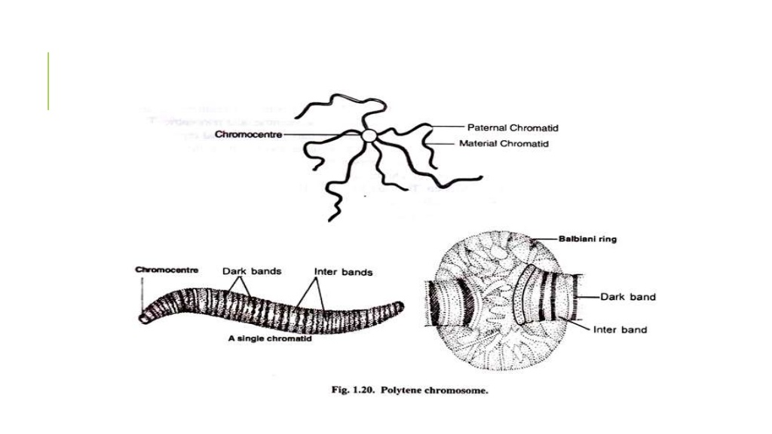
Specific structure of Polytene Chromosome
Fig: Polytene chromosomes

Slide 4
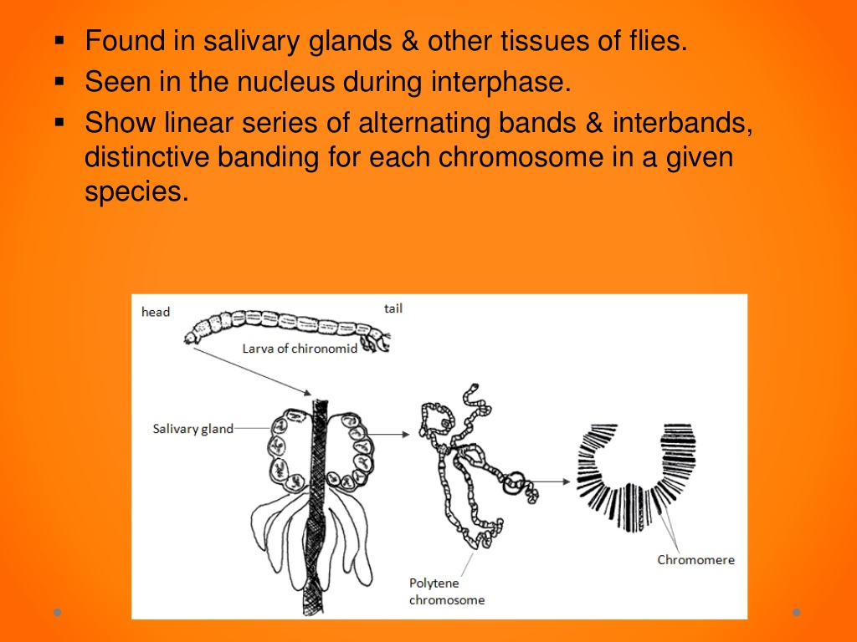
Structure of Polytene Chromosome
Specific features have been observed in the four chromosomes of Drosophila
It shows linear series of Bands and Interbands
Over 5000 bands have been observed in Polytene chromosomes of Drosophila
The Bands of Polytene chromosomes become enlarged due to uncoiling of individual chromomeres in a band which form swellings and are called chromosome puffs or Balbiani rings

Slide 5
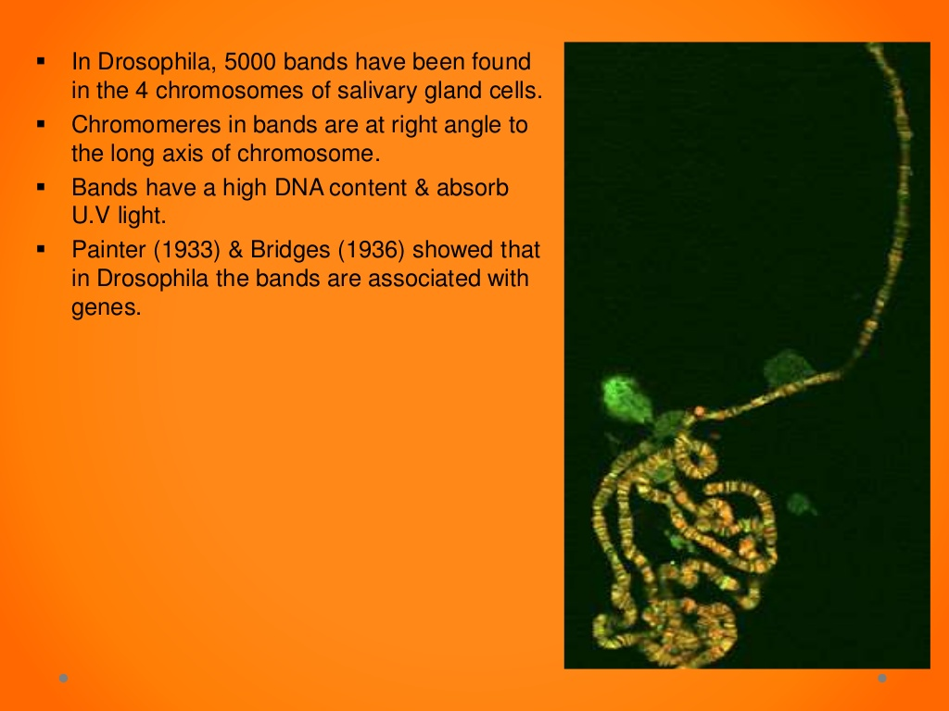

Slide 6
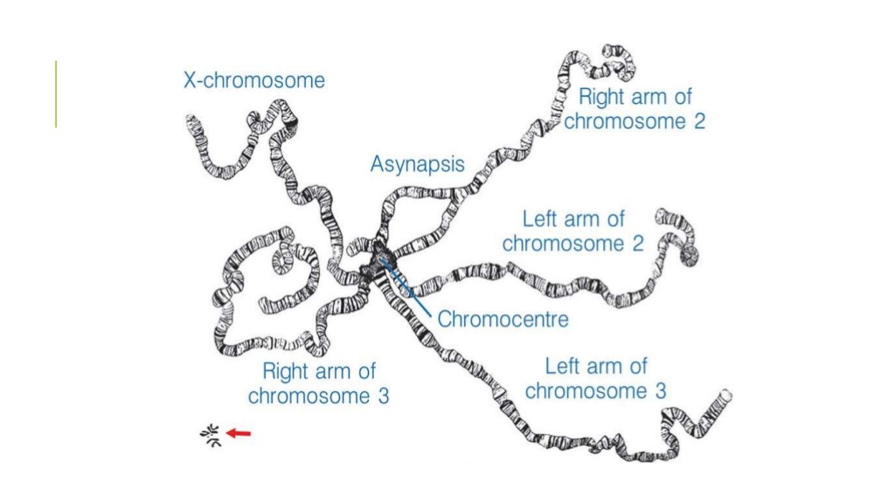
Detail Structure of Polytene Chromosome

Slide 7
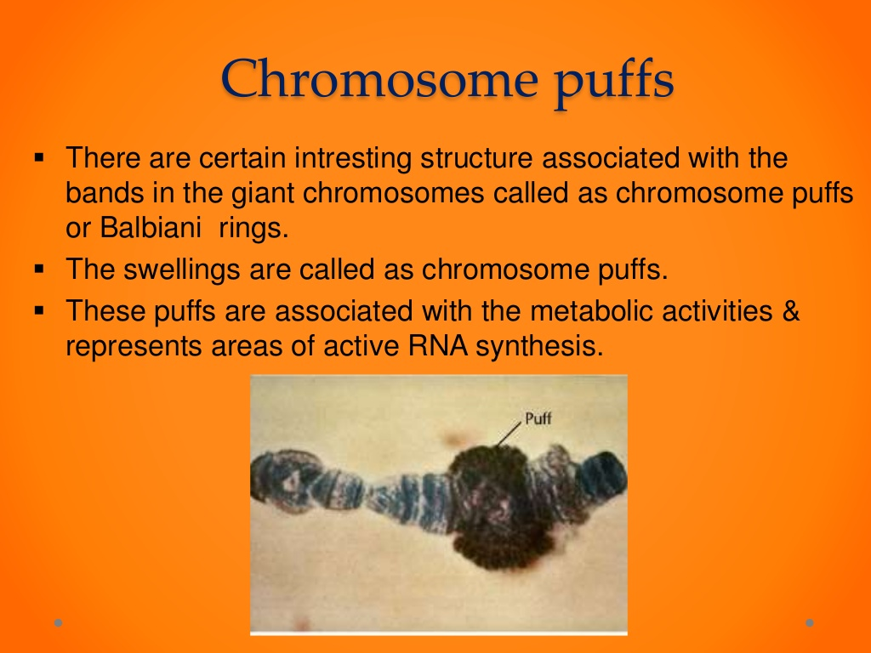
Balbiani Rings OR Chromosome Puffs

Slide 8
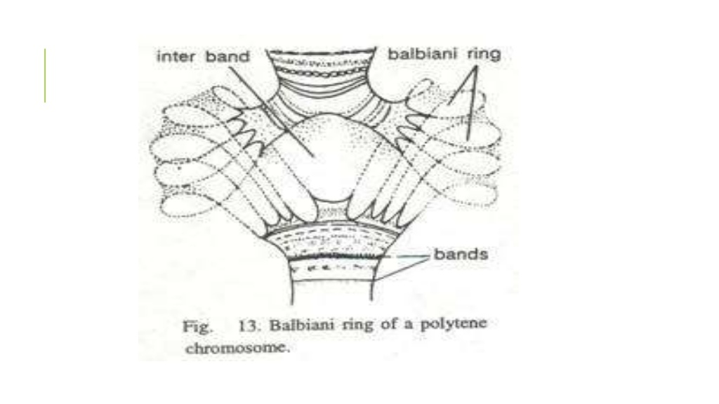
Fig: Balbiani Ring OR Chromosome Puffs

Slide 9
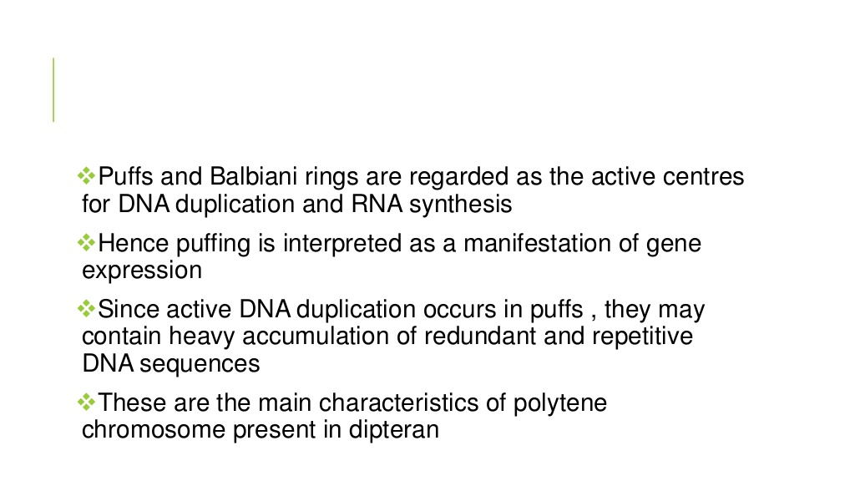
Balbiani Rings

Slide 10
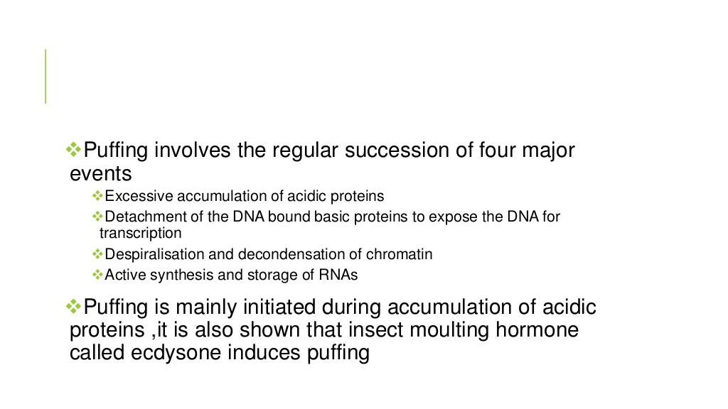
Balbiani Rings

Slide 11
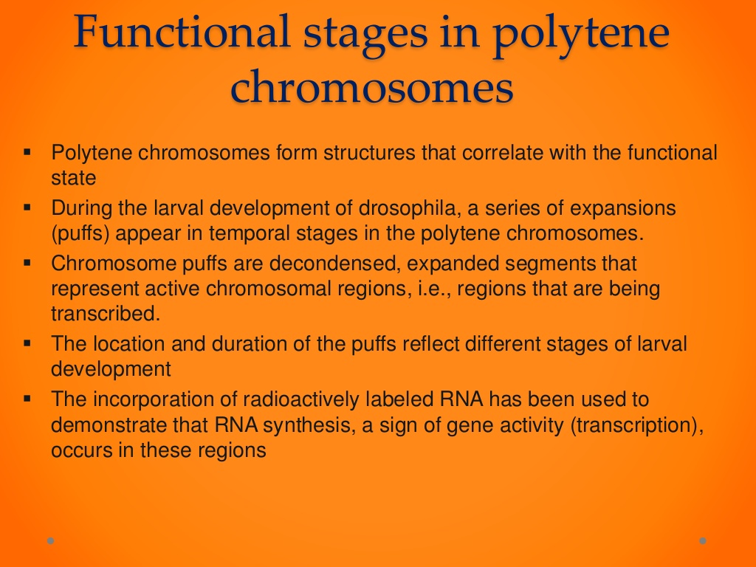
Functional stages of Polytene chromosome

Slide 12
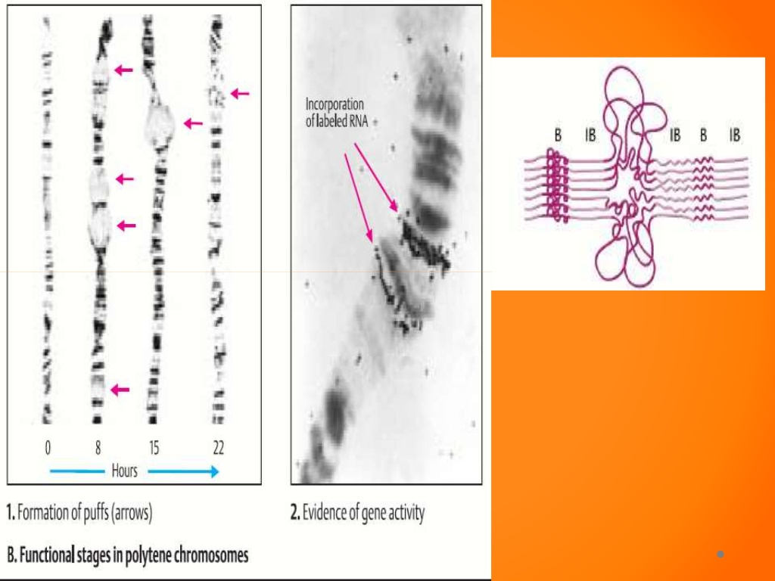
The incorporation of radioactively labeled RNA shows the activity of gene (transcription)

Slide 13
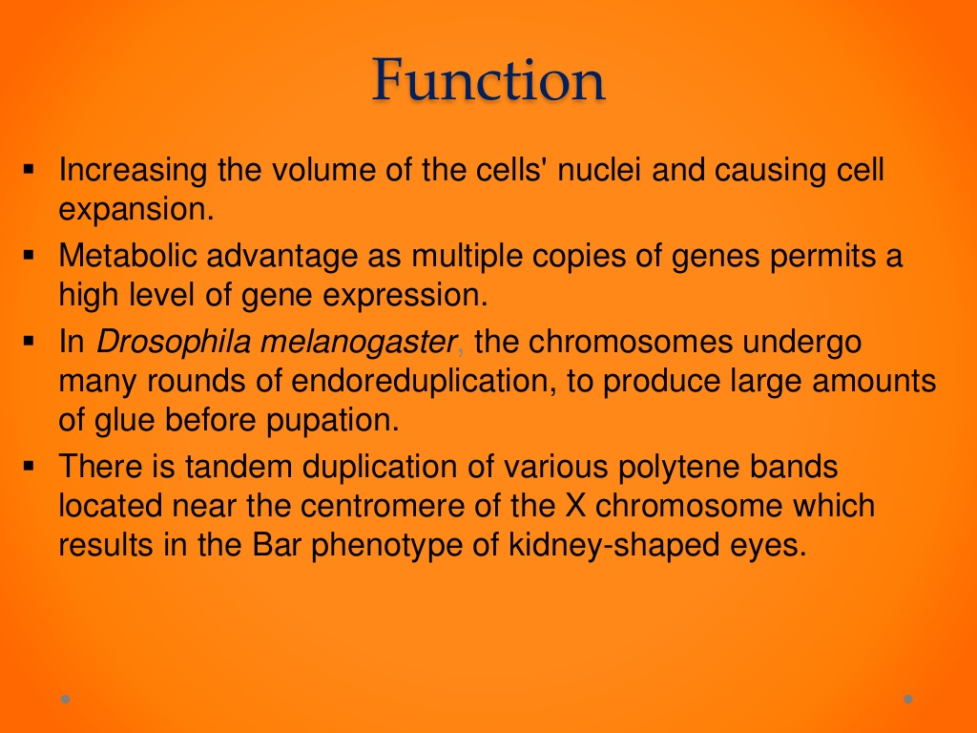
Functions of Polytene Chromosomes
Polytene chromosomes are used as bio-markers

Slide 14
Polytene Chromosomes
Students are requested to share their queries on Whatsapp group: MMC Botany (D2)
OR
khare.pushpanjali2@gmail.com
OR
# 9708063491

